Slide 1
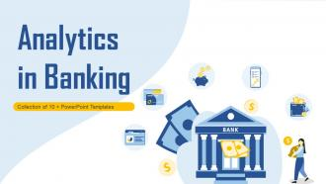

Bank Analysis Project
Vivek Shrinivas Satam

Slide 2
Project Title- Bank Analysis Project
Objectives-
Optimized bank operations through extensive analytics on loan portfolios, focusing on trend analysis, credit risk evaluation, and payment behavior comparison to enhance decision-making and risk management strategies.
Scope-
Comprehensive analysis of bank loan portfolios
Trend analysis
Credit risk evaluation
Payment behaviour comparison
PROJECT SUMMARY

Slide 3
Project Overview
In this project, I have used different types of analytical tools like Excel, Tableau, Power BI and SQL
Created different dashboards on Bank Analysis
Described various types of Key Performance Indicators (KPIs)

Slide 4
Key Performance Indicators (KPI)
Year wise loan amount
Stats Grade and sub grade wise revol_bal
Total Payment for Verified Status Vs Total Payment for Non Verified Status
State wise and month wise loan status
Home ownership Vs last payment date stats

Slide 5
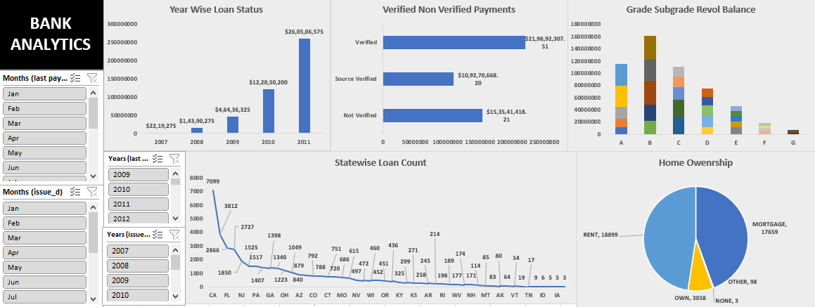
Excel dashboard

Slide 6
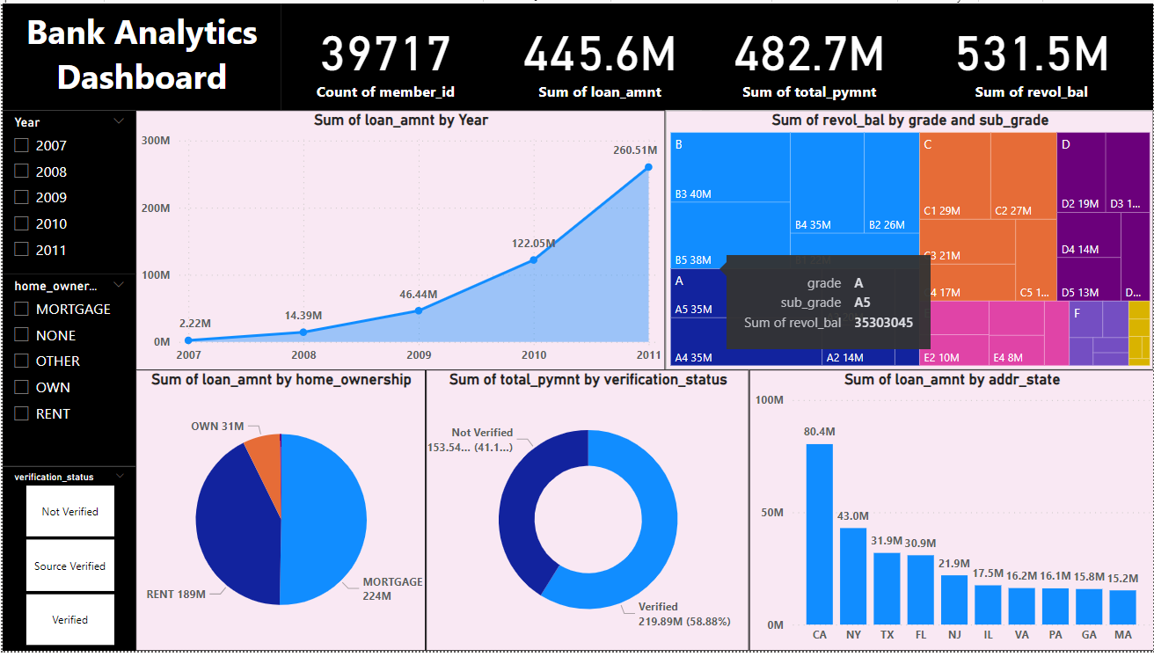
Power BI Dashboard

Slide 7
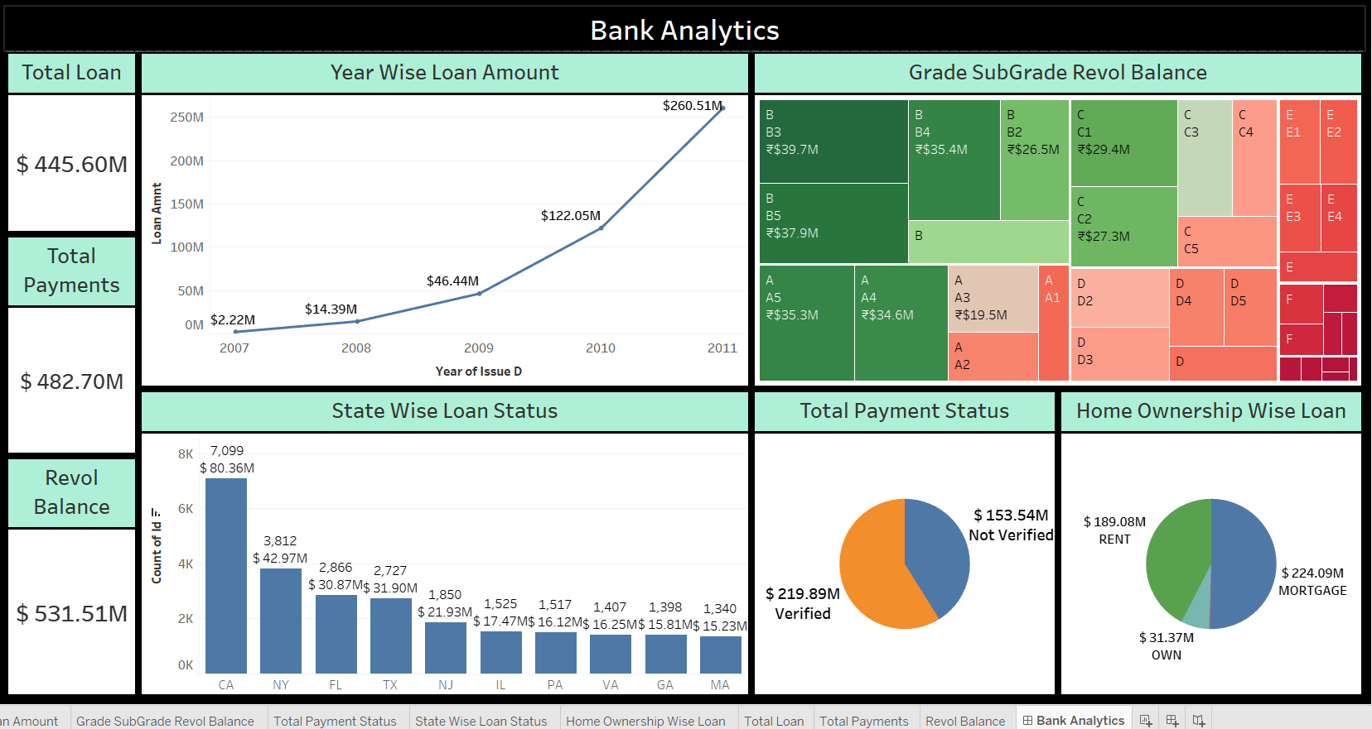
Tableau Dashboard

Slide 8
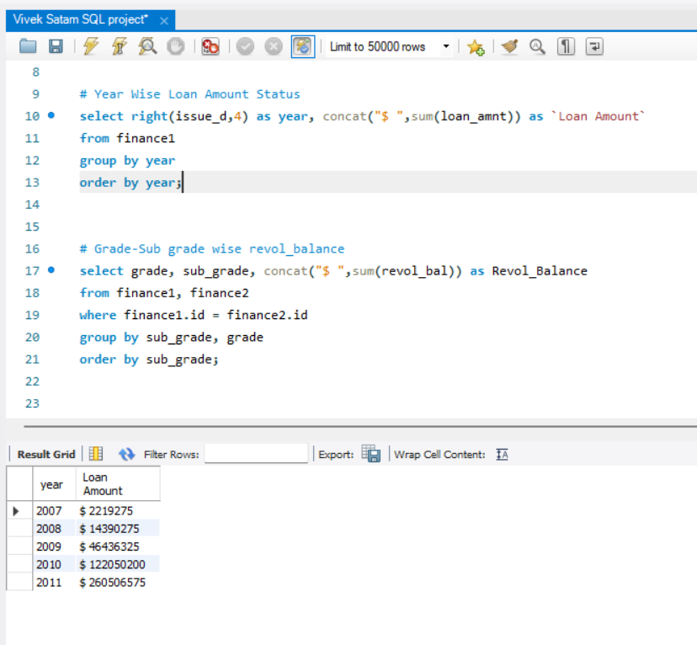
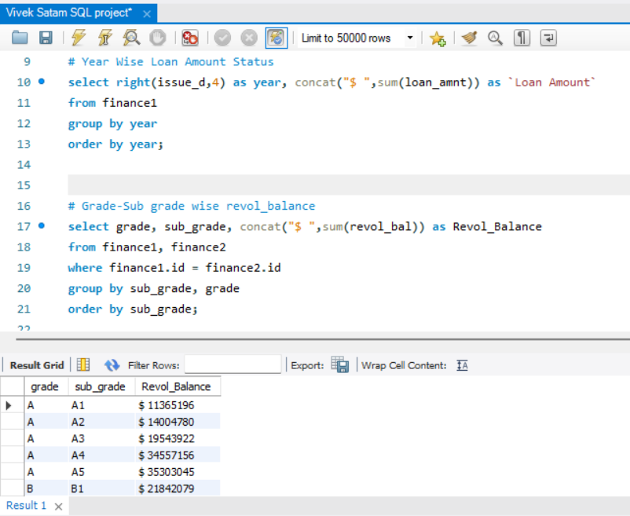
MySQL

Slide 9
Key Insights
The number of total members is 39717
The total loan amount is $445.6 millions
The total revolve balance amount is $531.5 millions
The highest loan amount of $260.51 millions was in year 2011
California is the state where highest loan amount of $80.4 millions
Mortgage home ownership is the highest one with loan amount of $224 millions
The overall amount of loan approvals and collections is increasing year by year

Slide 10
Key Takeaways
The project's comprehensive analytics utilizing tools like Excel, Tableau, Power BI, and SQL resulted in improved decision-making processes for bank operations.
Insights from KPIs, including year-wise loan amount trends, grade and subgrade-wise revolving balances, and payment behavior comparisons, offered a strategic understanding of loan portfolios.
The project's focus on credit risk evaluation and trend analysis contributes to a holistic risk management strategy, providing a nuanced perspective on potential challenges and opportunities in the bank's loan portfolios.

Slide 11
THANK YOU

